Slide 1
CZECH REPUBLIC
Living and Working
Notes:
1

Slide 3
Expat community
450 000
Italy 3 800
USA 5 700
United Kingdom 5 800
Bulgaria 10 000
Germany 19 700
Poland 19 800
Vietnam 56 400
Slovakia 96 000
Ukraine 103 000

Slide 4
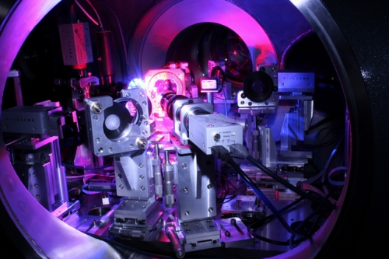
Czech Economy
OPEN, FLEXIBLE, EXPORT, INDUSTRIAL
automotive industry
metalworking
chemical production
electronic equipment
pharmaceuticals
business support services
software development
GDP + 4,3 % (2015) Currency Czech Koruna

Slide 5
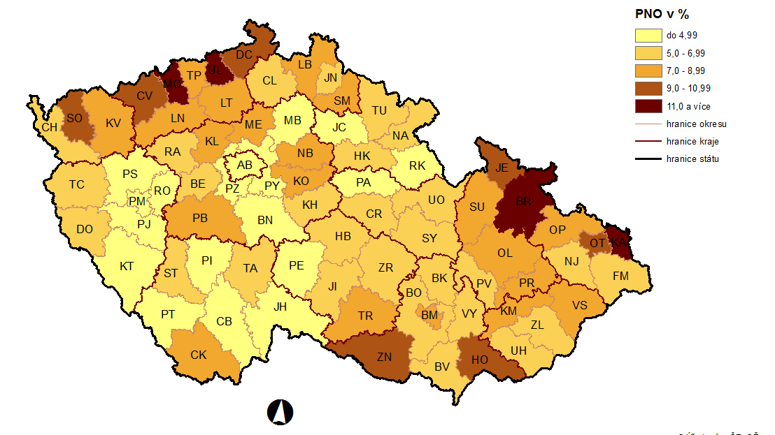
Labour Market (2/2016)
Unemployment 4,5 % (Eurostat, 1/2016) EU average 9,0 % Job vacancies (Labour Office) 115 000

Slide 6
LM Shortages
engineers, technicians, mechanics
IT, computer programmers
healthcare
customer service
sales representatives
chefs, waiters
drivers, warehouse operatives
assembly workers

Slide 7
TOP 7 – Engineering
Software Developer
IT analyst – developer
Computer Engineer
Automotive Engineer
Mechanical Engineer
Electrical Engineer
Electronic Engineer

Slide 8
Wages in Selected Sectors
Sector | EUR/month
Information and communication | 1 680
Electricity, gas, steam and air conditioning supply | 1 464
Professional, scientific and technical activities | 1 169
Financial and insurance activities | 1 708
Manufacturing | 904
Transportation and storage | 855
Construction | 812
Source: Czech Statistical Office, Czech National Bank

Slide 9
Wages in Technical Sector
Profession | Median in EUR/year
Software Engineer | 21 110
Senior Software Engineer | 30 255
Mechanical Engineer | 17 580
Electrical Engineer | 20 220
Network Engineer | 16 610
System Engineer (IT) | 12 930
Test/Quality Assurance Engineer | 23 580
Technical Support Engineer | 25 420
Project Manager (IT) | 26 650
IT Consultant | 27 310
Support Technician (IT) | 11 040
IT Specialist | 15 890
Support Engineer (IT) | 25 940
Business Analyst (IT) | 21 940

Slide 10
Costs of living in Prague (EUR)
rent a flat (1+1) 320
public transport ticket 1,14
taxi (1 km) 0,95
cinema ticket 6,1
men's haircut 10
lunch in restaurant 4,7
cappuccino (regular) 1,47
beer (0,5 l) 1,43

Slide 11
Deductions from Earnings (in %)
worker employer
health insurance 4,5 9
social insurance 6,5 25
income tax 15

Slide 12
Looking for a Job
EURES www.eures.cz
www.eures.europa.eu
Euraxess www.euraxess.cz
Labour Office www.portal.mpsv.cz
media & internet www.jobs.cz
www.expats.cz
www.profesia.cz
www.hotjobs.cz
www.jobmaster.cz

Slide 13
Work in the Czech Republic
No work permit for EU/EEA citizens
No residence permit
Registration with Foreign Police
Registration at Labour Office

Slide 14
What is needed when looking for a job
language skills – Czech (English, German)
CV – structured, Europass
interview
specified by employer:
criminal records check
health certificate
psychological tests

Slide 15
Labour Law
Written employment contract: work position, location, work starting day
trial period – usually 3 months
holidays – min. 4 weeks/year
2 months notice period
Problems at work?
State Labour Inspection Office
Trade Unions
Labour Office

Slide 16
Unemployment
Unemployment benefits at least 12 months of employment within last 2 years
till 50 years 5 months
50 – 55 years 8 months
55+ 11 months
first two months 65 %
next two months 50 %
remaining period 45 %

Slide 17
Tomas Kracmar Labour Office CZ +420 950 141 320 eures@ol.mpsv.cz
www.eures.cz
www.eures.europa.eu

