Slide 1


Working and Living in Germany
International and Specialized Placement Services (ZAV)
Verena Lucía Landes,
Turin, April 2016
Welcome to Germany!
Notes:
Title slide, alternative photo, for selection.

Slide 2
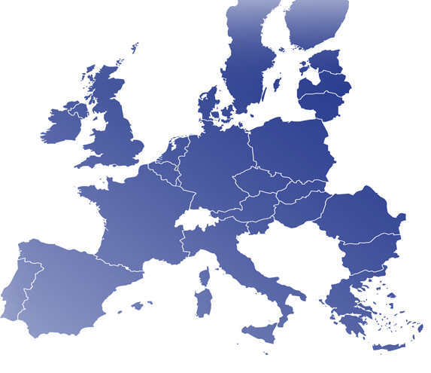





International and Specialized Placement Services (ZAV)
  Member of EURES Network
Provides services for:
  Jobseekers from abroad
  German repatriates
  German employers
Our responsibilities include:
  Placement for jobseekers from abroad
  Specific recruitment events in country of origin
  Information and advice about the German Labor Market and employment opportunities
Notes:
The presentation can be built on with additional facts about the economic climate, e.g. unemployment rate

Slide 3

Counseling available through different channels
Individualisierte
Bewerber-Beratung
Individualized counseling for applicants
Individualized counseling for employers
Main services:
  Individual counseling in all areas (pre and post arrival)
  Guiding through necessary local administrative processes
  Supporting spouse in job search
  Aid integration in cooperation with local community centers
I
Main services:
  Individual counseling regarding: recognition of professions, access to the German Labor Market etc.
Services for applicants
Migration Support Center
services for employers
channels of communicationn
Telephone
E-Mail
Access through:
  Hotlines: ZAV and MiiG
Access through:
  E-mail addresses: ZAV and MiiG
  MiiG contact form
Live Text Chat
MiiG Website
Notes:
The presentation can be built on with additional facts about the economic climate, e.g. unemployment rate

Slide 4
International Placement Services (IPS)
  Job placement for foreign jobseekers
    Providing information on working and living in Germany as well as possible EU Programs (like MobiPro, Your first Eures Job)
    Recruiting applicants in other EU countries (EURES)
    Searching for applicants in the applicant pool of EURES-Germany
Notes:
The presentation can be built on with additional facts about the economic climate, e.g. unemployment rate

Slide 5
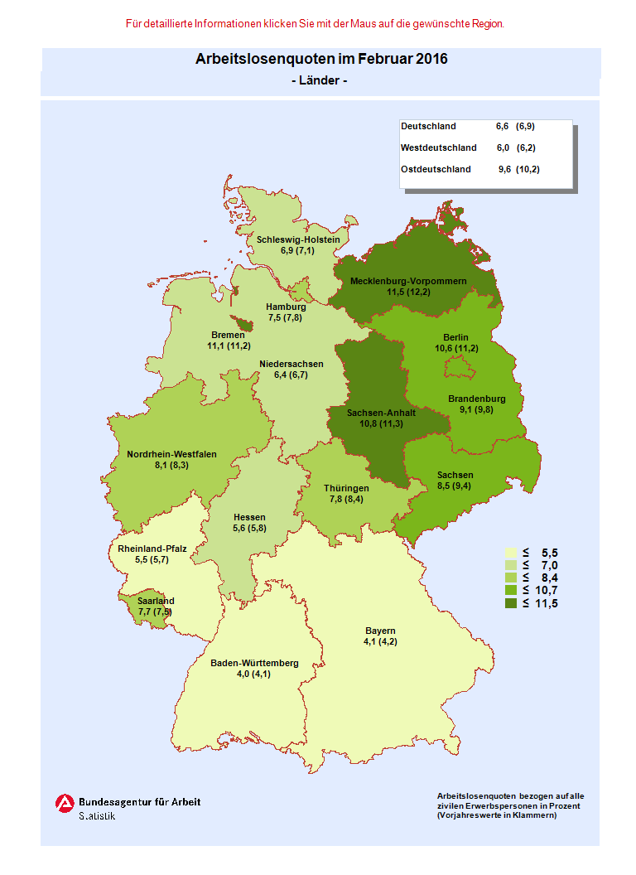
Working and Living in Germany
  The German Labor Market
  Germany is looking for well-trained skilled workers …
  … but there are also regions with high levels of unemployment.
  Unemployment rates February 2016:
  Germany: 6.6 %
  Western States: 6.0 %
  Eastern States: 9.6 %
Notes:
Animation flies in from left by clicking
Source: www.make-it-in-germany.de

Slide 6


We offer opportunities for skilled workers.
Germany is looking for ...
Labor demand in following professions:
Engineers and IT specialists
Medical doctors
Nurses
Hotel and catering staff
Metal workers and electricians
Housekeepers and care givers for the elderly
Notes:
Current trends, see employment bottleneck analysis
CNC=Computerized Numerical Control
http://statistik.arbeitsagentur.de/Statischer-Content/Arbeitsmarktberichte/Fachkraeftebedarf-Stellen/Fachkraefte/

Slide 7

Requirements for most professions
Successfully completed formation
Good/excellent German skills
(B1-Level – intermediate level)
Often English skills desired
Work experience
Motivation
Capacity for teamwork
Willingness to acquire new skills
Appealing CV
Notes:
Current trends, see employment bottleneck analysis
CNC=Computerized Numerical Control
http://statistik.arbeitsagentur.de/Statischer-Content/Arbeitsmarktberichte/Fachkraeftebedarf-Stellen/Fachkraefte/

Slide 8
Legal access to the German Labor Market
Free access to the German Labor Market for citizens of EU/EEA member states
Members of third party countries need in general a work permit
(High-Potentials with an annual gross income of at least 49,602 € or 38,688 € if they have a profession in high demand → Blue Card EU)
Notes:
Current trends, see employment bottleneck analysis
CNC=Computerized Numerical Control
http://statistik.arbeitsagentur.de/Statischer-Content/Arbeitsmarktberichte/Fachkraeftebedarf-Stellen/Fachkraefte/

Slide 9

Wages in Germany
Collective agreements and minimum wages – in many sectors the wage level is determined by collective wage or house agreement
Significant regional wage differences (east-west/north-south)
In Germany the stated salary is usually gross salary - net salary is less
Statutory minimum wage in Germany (8,50 €/per hour)
Notes:
Animation flies in by clicking
There are no regulations in place for a statutory minimum wage. Exception for certain sectors.
In general there are collective agreements in place for each sector.
Significant regional wage differences (east-west/north-south)
Wages: monthly gross salary– the net salary is less

Slide 10

The German Social Insurance System
Accident Insurance (employer contribution)
2.35 % Long-term Care Insurance
3 % Unemployment Insurance
14.6 % Health Insurance
18.7 % Pension Insurance
Notes:
Animation appears
Five pillars of the social insurance scheme:
Rate:
Health insurance 15.5 %
Unemployment insurance 3.0 %
Pension insurance 18.9 %
Long-term care insurance 2.05 %
Accident insurance paid by employer
For further information, see: www.deutsche-sozialversicherung.de

Slide 11
Social Security Scheme and Taxation
Social Security System:
Health Insurance 14.60 %
Unemployment Insurance 3.00 %
Pension 18.70 %
Long-Term Care Insurance 2.35 %
Work Accident Insurance paid by employer
  Taxation
  Income Tax → 14 % - 45 % (Depending on income and marital status)
Church Tax → 8 % - 9 % of Income Tax
Solidarity Tax → 5.5 % of Income Tax
Automatically deducted from the salary
Registration to the social insurance system is made by the employer
Notes:
Animation appears

Slide 12
Sample Salary Statement
 |  | Month | Year
Salary |  | 3,000 € | 36,000 €
Social Security Contributions
Pension |  | 280.50 € | 3,366.00 €
Unemployment Insurance |  | 45.00 € | 540.00 €
Health Insurance |  | 219.00 € | 2,628.00 €
Long-term Care Insurance |  | 42.75 € | 513.00 €
Total Social Contributions |  | 587,25 € | 7.047,00 €
Taxation
Solidarity Tax |  | 24.74 € | 296.88 €
Church Tax |  | 40.84 € | 485.82 €
Income Tax |  | 449.83 € | 5.397,96 €
Total Taxation |  | 515.05 € | 6,180.66 €
Salary after deductions |  | 1,897.70 € | 22,772.34 €
Notes:
Animation appears

Slide 13
How do I find a job?
Send your CV to the ZAV
workingermany@arbeitsagentur.de
Federal Employment Agency’s Job Exchange (Jobbörse)
www.jobboerse.arbeitsagentur.de
Job vacancies in German companies can also be found in the EURES portal
www.ec.europa.eu/eures

Slide 14
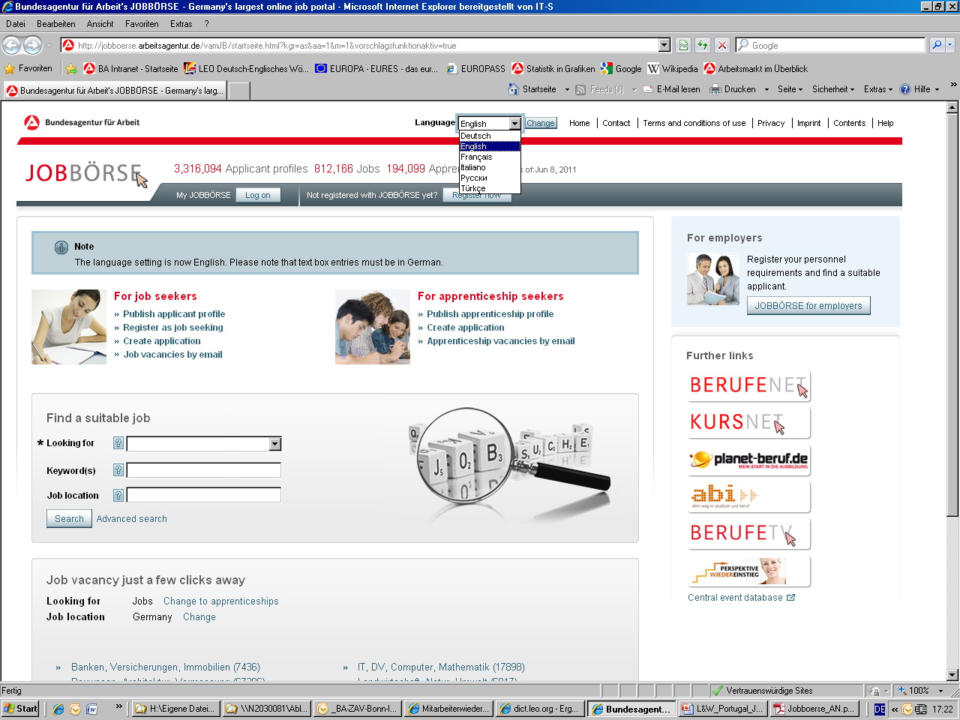
Federal Employment Agency‘s Job Exchange (Jobbörse)
Select language
Register/log in
Quick search/
Advanced search
Notes:
Videos on the Job Exchange in English and Spanisch:
http://www.arbeitsagentur.de/web/content/DE/BuergerinnenUndBuerger/Detail/index.htm?dfContentId=L6019022DSTBAI554985

Slide 15
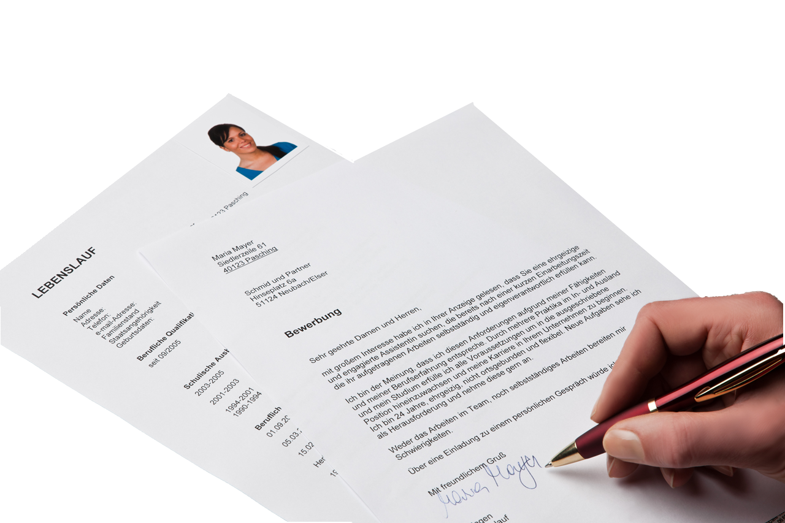
How do I apply?
Photo is expected
Cover letter: 1 page
Get ready!
We offer online application training, including training for university graduates in particular
www.berufe.tv/weitere-filme/bewerbungstraining/bewerbungstraining-fuer-akademiker/
Curriculum Vitae
Take ideas from the Europass CV
for your own application!
https://europass.cedefop.europa.eu/cvonline/
Notes:
Animation appears, flies in by clicking
Europass https://europass.cedefop.europa.eu/cvonline/
online application training http://www.berufe.tv/BA/weitereFilme/?familyID=1000027&family=Bewerbungstraining
online application for training for university graduates https://lernboerse.arbeitsagentur.de/aktiv/media/akademiker/101005_bewerbungstraining/index.htm
(each one is linked to from the text in the slide - Hinweis des Übersetzers – wahrscheinlich nicht mehr verlinkt in der Übersetzung!”
CV and covering letter, photo (optional)
Please use the Europass CV template for your application!

Slide 16


Thank you for your attention!
Zentrale Auslands- und Fachvermittlung (ZAV)
Villemombler Straße 76
D-53123 Bonn
Telefon: + 49 (0)228 713-1313
Homepage: www.make-it-in-germany.de
E-Mail: workingermany@arbeitsagentur.de

